Slide 1


Milestone Meeting
Navigating the complexities of medical information can be overwhelming, yet essential for making critical health decisions!
Our QA-system bridges this gap by simplifying the intricate world of medical knowledge!
Created using ChatGPT-4 with DALL·E
Created using ChatGPT-4 with DALL·E
Sandra Friebolin, Matteo Malvestiti, Yusuf Berber

Slide 2

Index
Dataset Download & Pre-Processing
Documents’ Database
Embeddings
Vector Database
Ongoing & Upcoming Steps
Dataset
Our choice:
Sandra Friebolin, Matteo Malvestiti, Yusuf Berber
Notes:
Fin qua 4 minuti
Description of our problem environment
Emitter with small radius
Collector non in mesh
BCs
Initial refinement at emitter (not distorted mesh, emitter is our interest)

Slide 3
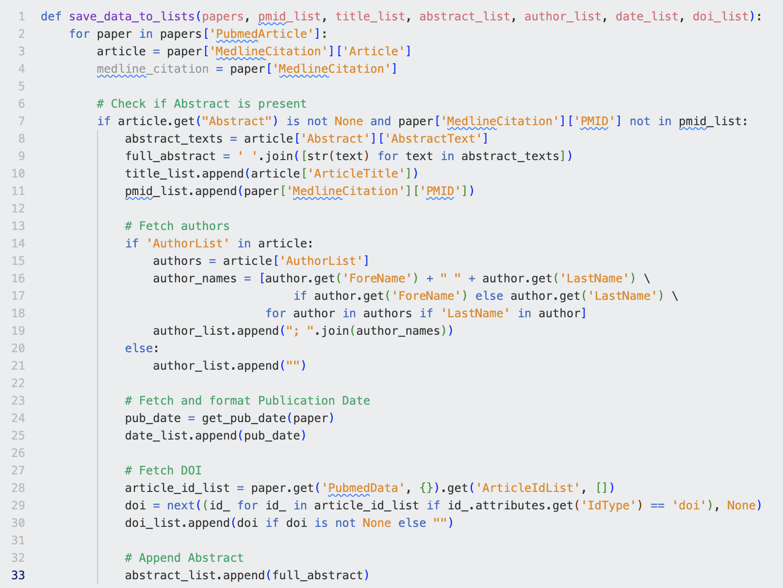
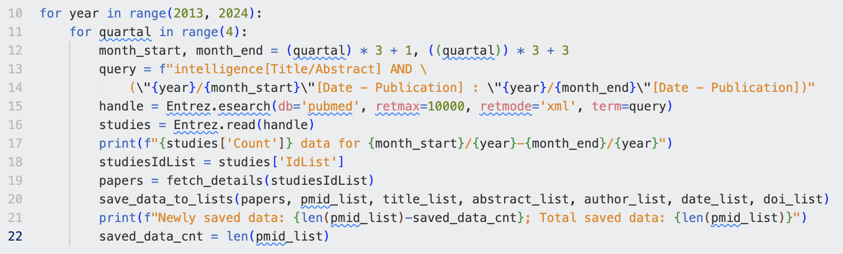
Download Data via Python Script
Sandra Friebolin, Matteo Malvestiti, Yusuf Berber
Notes:
Fin qua 4 minuti
Description of our problem environment
Emitter with small radius
Collector non in mesh
BCs
Initial refinement at emitter (not distorted mesh, emitter is our interest)

Slide 4

Download Data via Python Script
BioPython Entrez API used for querying and fetching data
Downloaded in XML format
Retrieved titles, abstracts, authors, publication dates, DOIs
Handling of API limitations:
Download data segmented by each quarter within years
Sequentially gathered data in batches
Sandra Friebolin, Matteo Malvestiti, Yusuf Berber
Notes:
Fin qua 4 minuti
Description of our problem environment
Emitter with small radius
Collector non in mesh
BCs
Initial refinement at emitter (not distorted mesh, emitter is our interest)

Slide 5
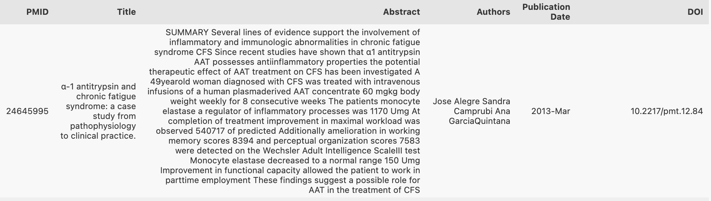
Pre-Processing
Replaced missing values: NaN → string “Unknown”
Removed special characters/normalized text: e.g. in Scandinavian names
Cleaned non-breaking spaces and trailing whitespaces
To-Do: experiment with stop-word removal, n-grams/phrases, lemmatization
Sandra Friebolin, Matteo Malvestiti, Yusuf Berber
Notes:
Fin qua 4 minuti
Description of our problem environment
Emitter with small radius
Collector non in mesh
BCs
Initial refinement at emitter (not distorted mesh, emitter is our interest)

Slide 6


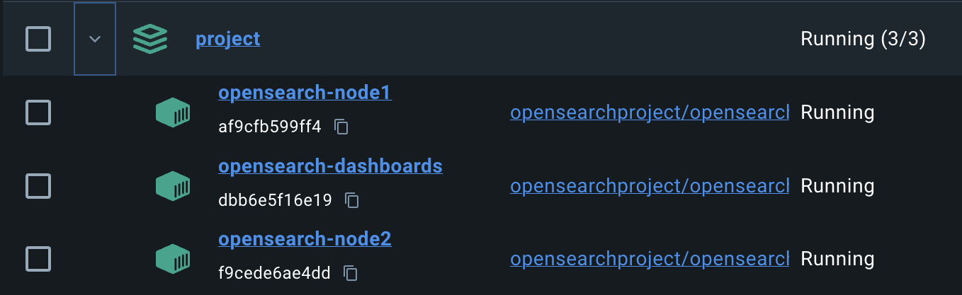
Index
Dataset Download & Pre-Processing
Documents’ Database
Embeddings
Vector Database
Ongoing & Upcoming Steps
OpenSearch
Sandra Friebolin, Matteo Malvestiti, Yusuf Berber
Notes:
Poisson formula
Representation of f and why is negligible
BCs

Slide 7
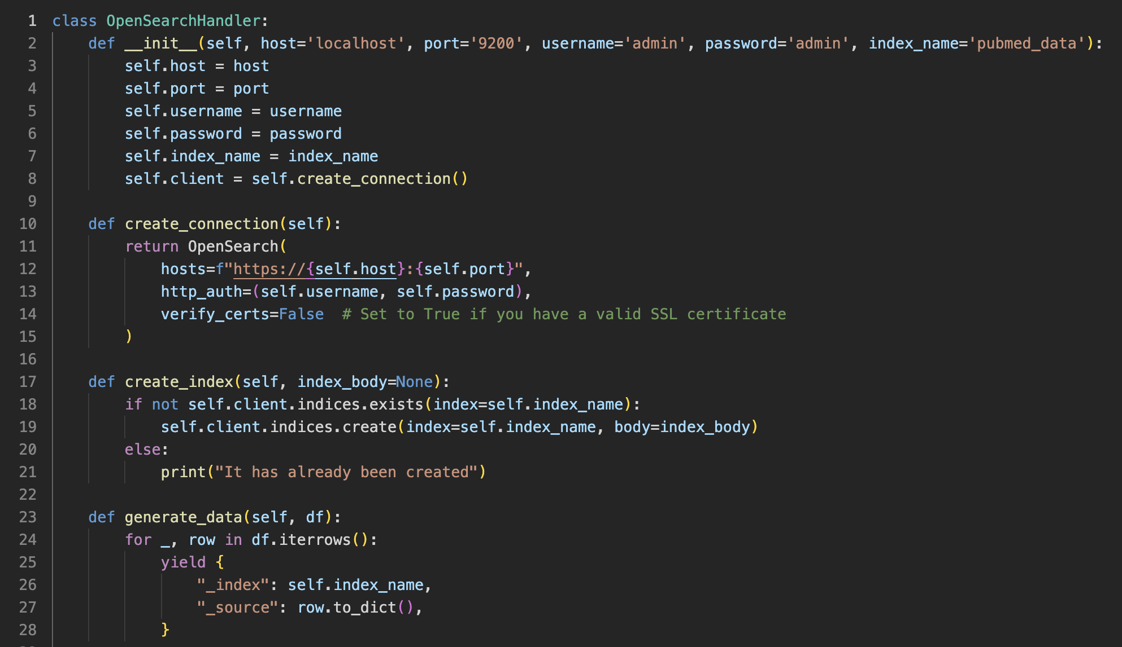
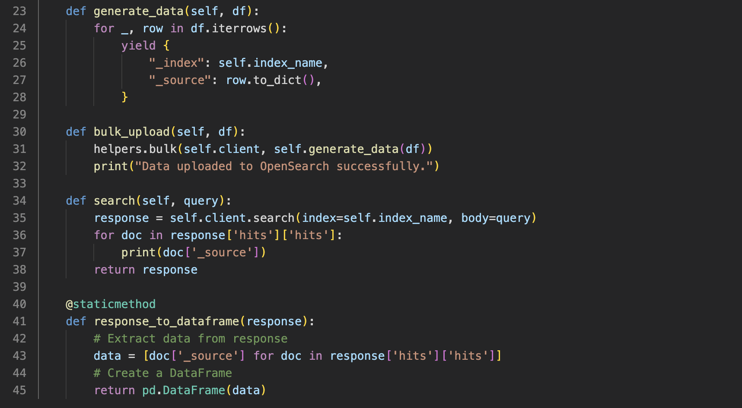
We handle the connection through a python notebook
Sandra Friebolin, Matteo Malvestiti, Yusuf Berber
Notes:
Fin qua 4 minuti
Description of our problem environment
Emitter with small radius
Collector non in mesh
BCs
Initial refinement at emitter (not distorted mesh, emitter is our interest)

Slide 8
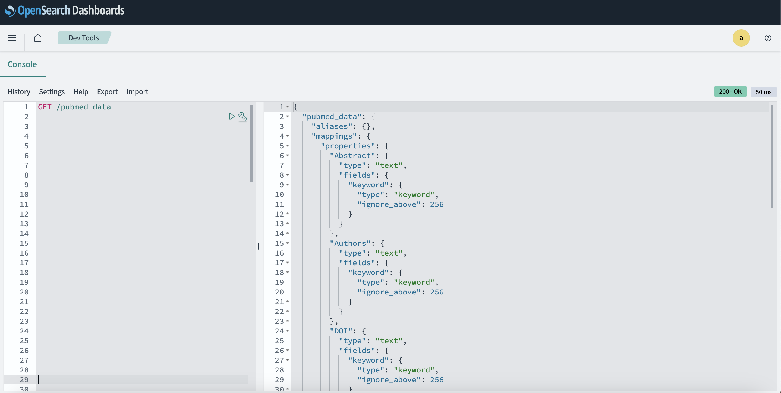
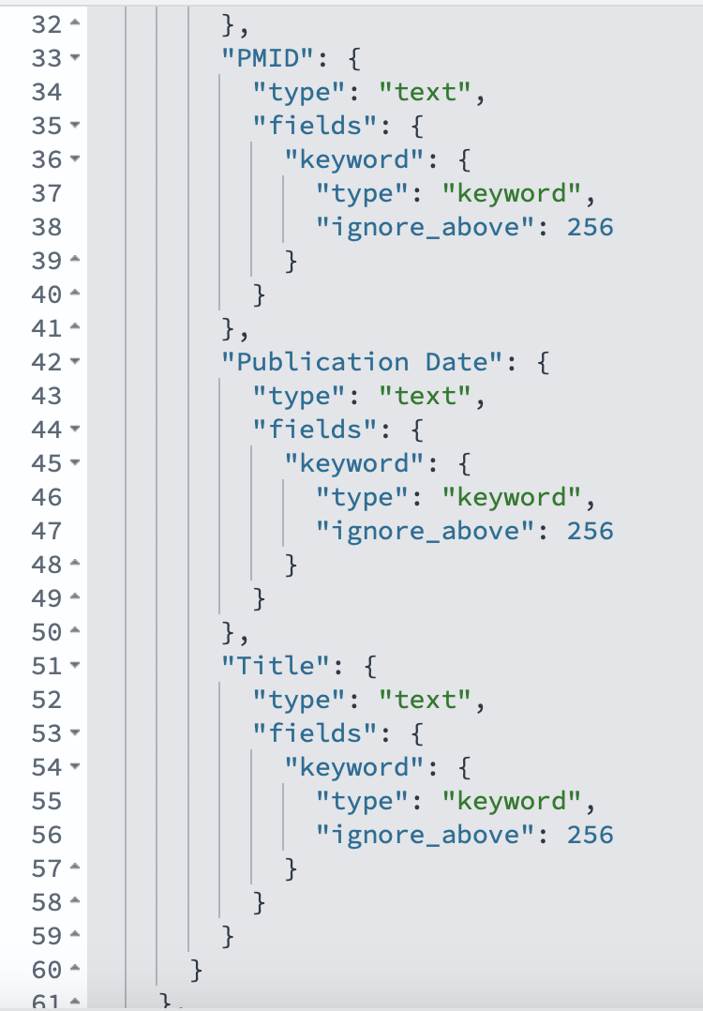
How the index looks like
a question for later
Sandra Friebolin, Matteo Malvestiti, Yusuf Berber
Notes:
Fin qua 4 minuti
Description of our problem environment
Emitter with small radius
Collector non in mesh
BCs
Initial refinement at emitter (not distorted mesh, emitter is our interest)

Slide 9
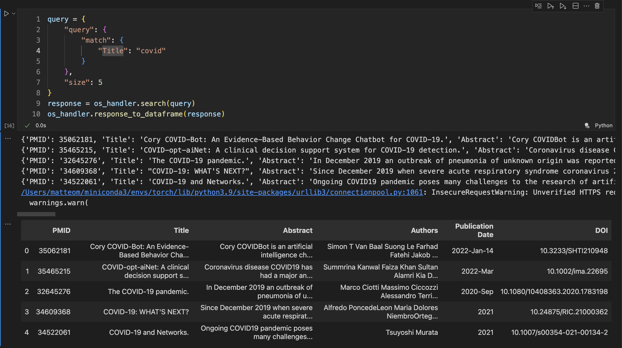
Some query example to prove it’s working properly
Many results for “covid”
Sandra Friebolin, Matteo Malvestiti, Yusuf Berber
Notes:
Fin qua 4 minuti
Description of our problem environment
Emitter with small radius
Collector non in mesh
BCs
Initial refinement at emitter (not distorted mesh, emitter is our interest)

Slide 10
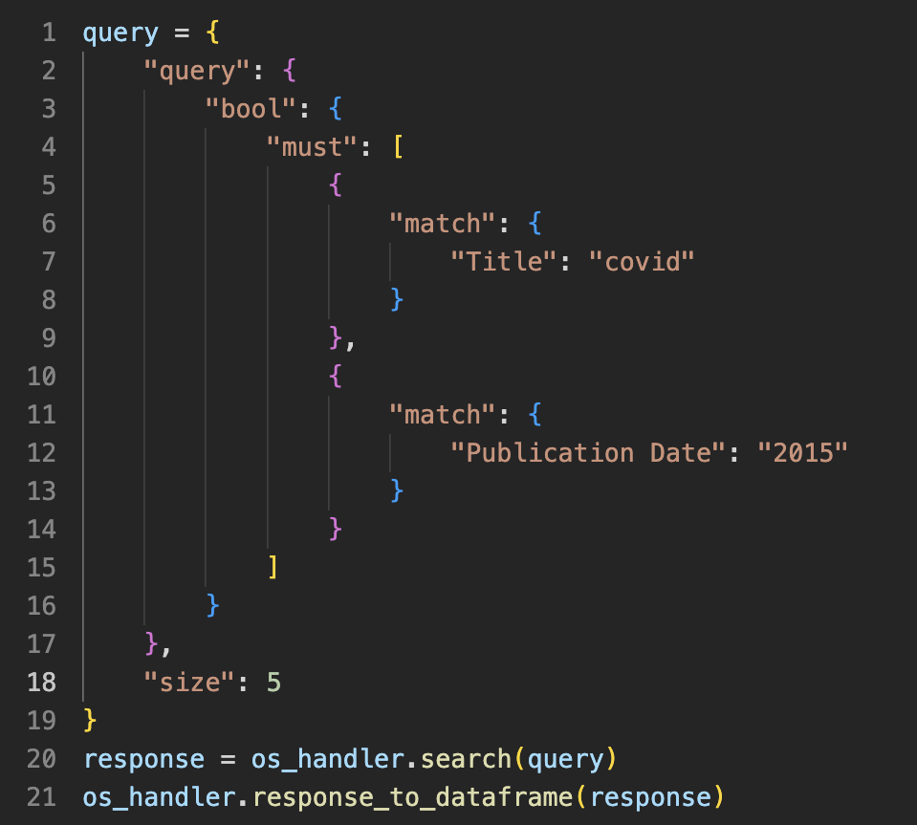
Some query example to prove it’s working properly
Something more elaborated:
a Boolean search
No mentions for covid in 2015! Didn’t anyone write about it before the pandemic??
Sandra Friebolin, Matteo Malvestiti, Yusuf Berber
Notes:
Fin qua 4 minuti
Description of our problem environment
Emitter with small radius
Collector non in mesh
BCs
Initial refinement at emitter (not distorted mesh, emitter is our interest)

Slide 11
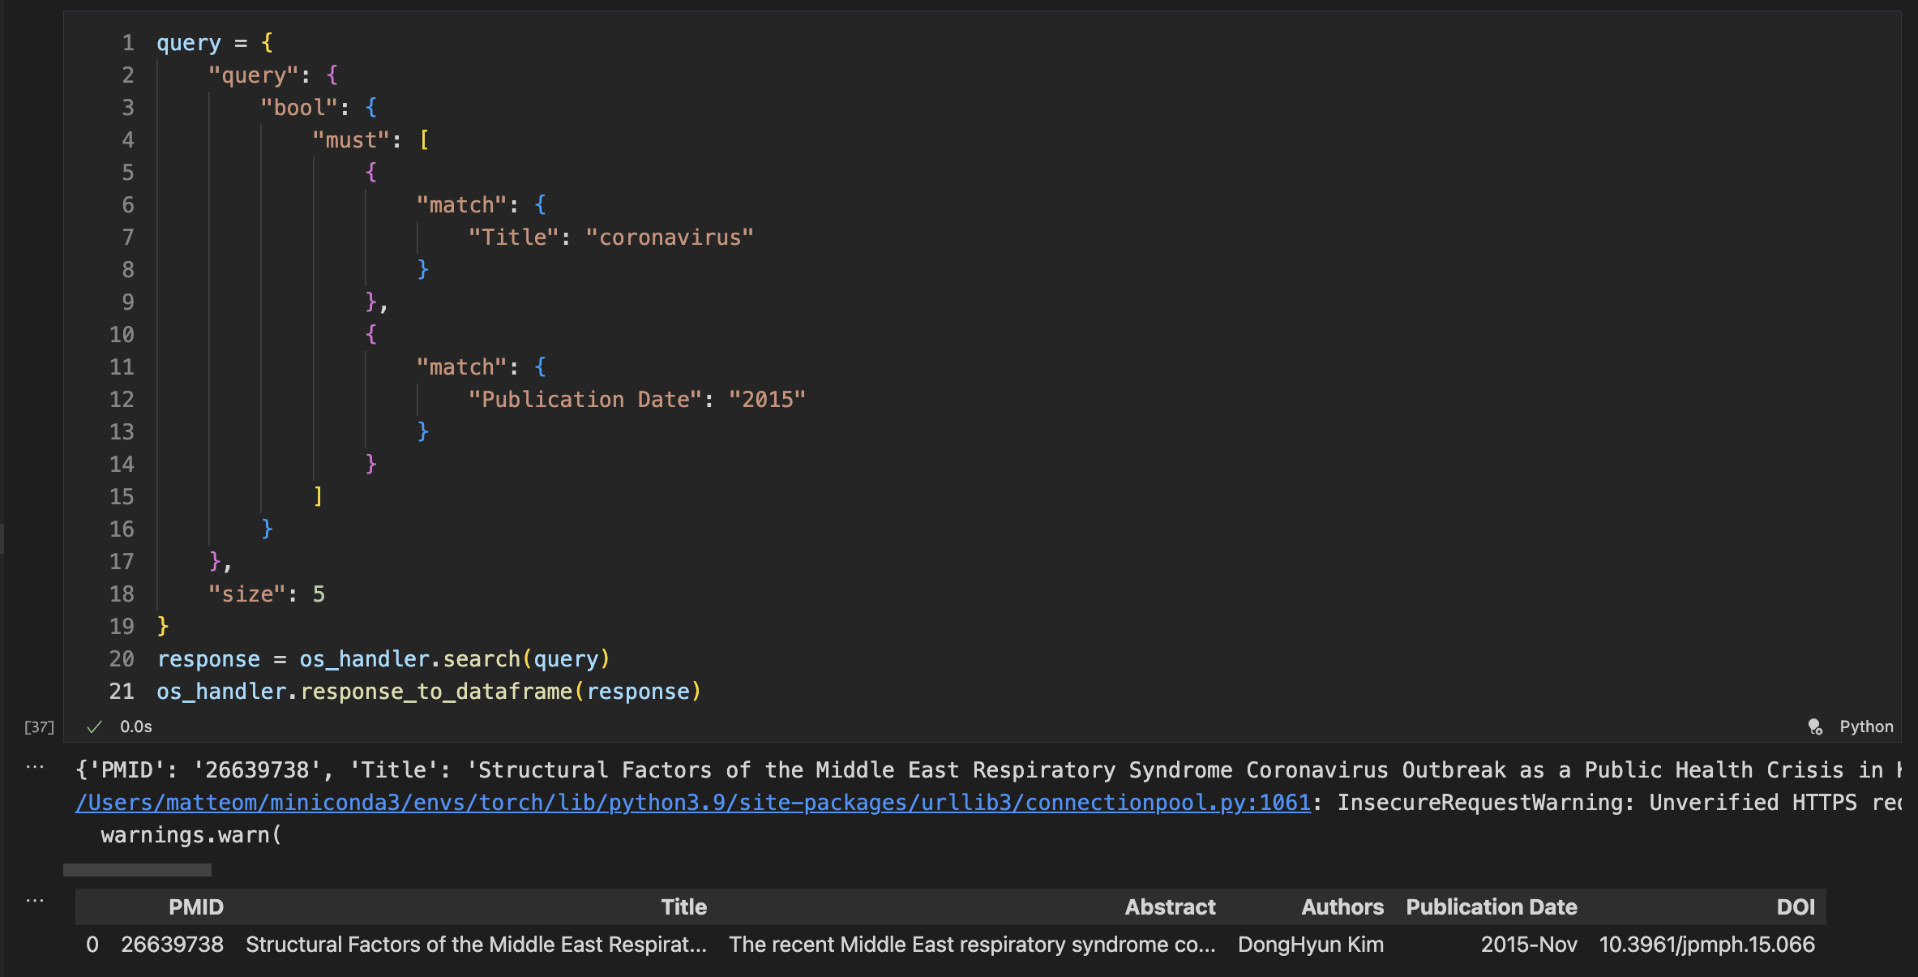
Some query example to prove it’s working properly
'Title': 'Structural Factors of the Middle East Respiratory Syndrome Coronavirus Outbreak as a Public Health Crisis in Korea and Future Response Strategies.'
Test: Successful
It’s working
Sandra Friebolin, Matteo Malvestiti, Yusuf Berber
Notes:
Fin qua 4 minuti
Description of our problem environment
Emitter with small radius
Collector non in mesh
BCs
Initial refinement at emitter (not distorted mesh, emitter is our interest)

Slide 12
Index
Dataset Download & Pre-Processing
Documents’ Database
Embeddings
Vector Database
Ongoing & Upcoming Steps
1) BioBERT
domain-specific adaptation of BERT, pre-trained on large PubMed corpus
captures context & semantics of biomedical texts
used pre-trained version
To-Do: fine-tune on own data?
2) To-Do: Embedding-Pipeline
test different embedding models, e.g. SGPT-5.8B-msmarco (best results for semantic retrieval, see MTEB: Massive Text Embedding Benchmark)
Sandra Friebolin, Matteo Malvestiti, Yusuf Berber
Notes:
Poisson formula
Representation of f and why is negligible
BCs

Slide 13
Live-Demo: Retrieval of most similar abstracts based on test queries
Sandra Friebolin, Matteo Malvestiti, Yusuf Berber
Notes:
Fin qua 4 minuti
Description of our problem environment
Emitter with small radius
Collector non in mesh
BCs
Initial refinement at emitter (not distorted mesh, emitter is our interest)

Slide 14
Index
Dataset Download & Pre-Processing
Documents’ Database
Embeddings
Vector Database
Ongoing & Upcoming Steps
Pinecone
Account Type: Free-Tier, with limitations.
‘PineconeHandler’ class for various operations within Pinecone
‘upload_embeddings’ notebook to upsert embeddings into pinecone
Upsert in batches
Metric: Cosine similarity
Sandra Friebolin, Matteo Malvestiti, Yusuf Berber
Notes:
Poisson formula
Representation of f and why is negligible
BCs

Slide 15
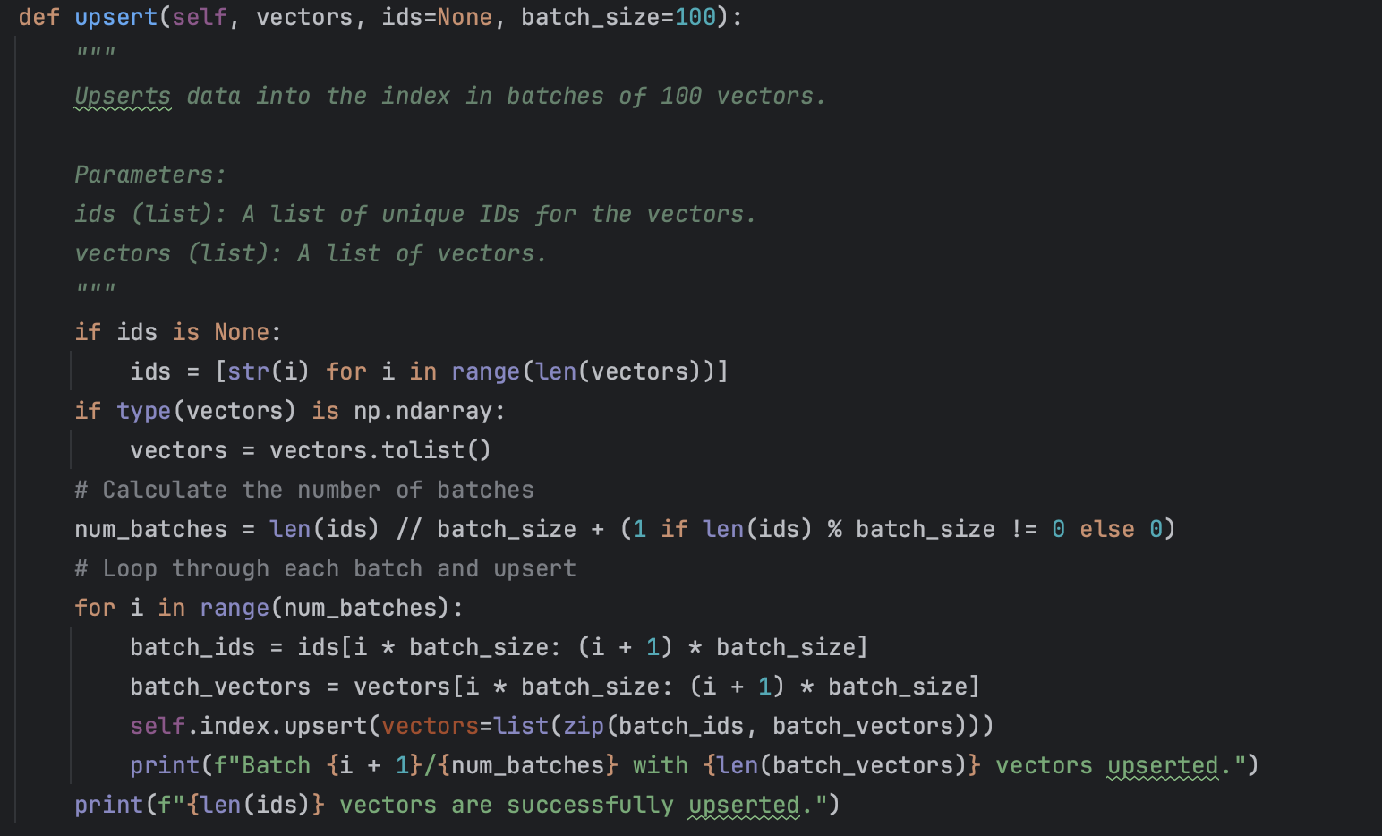
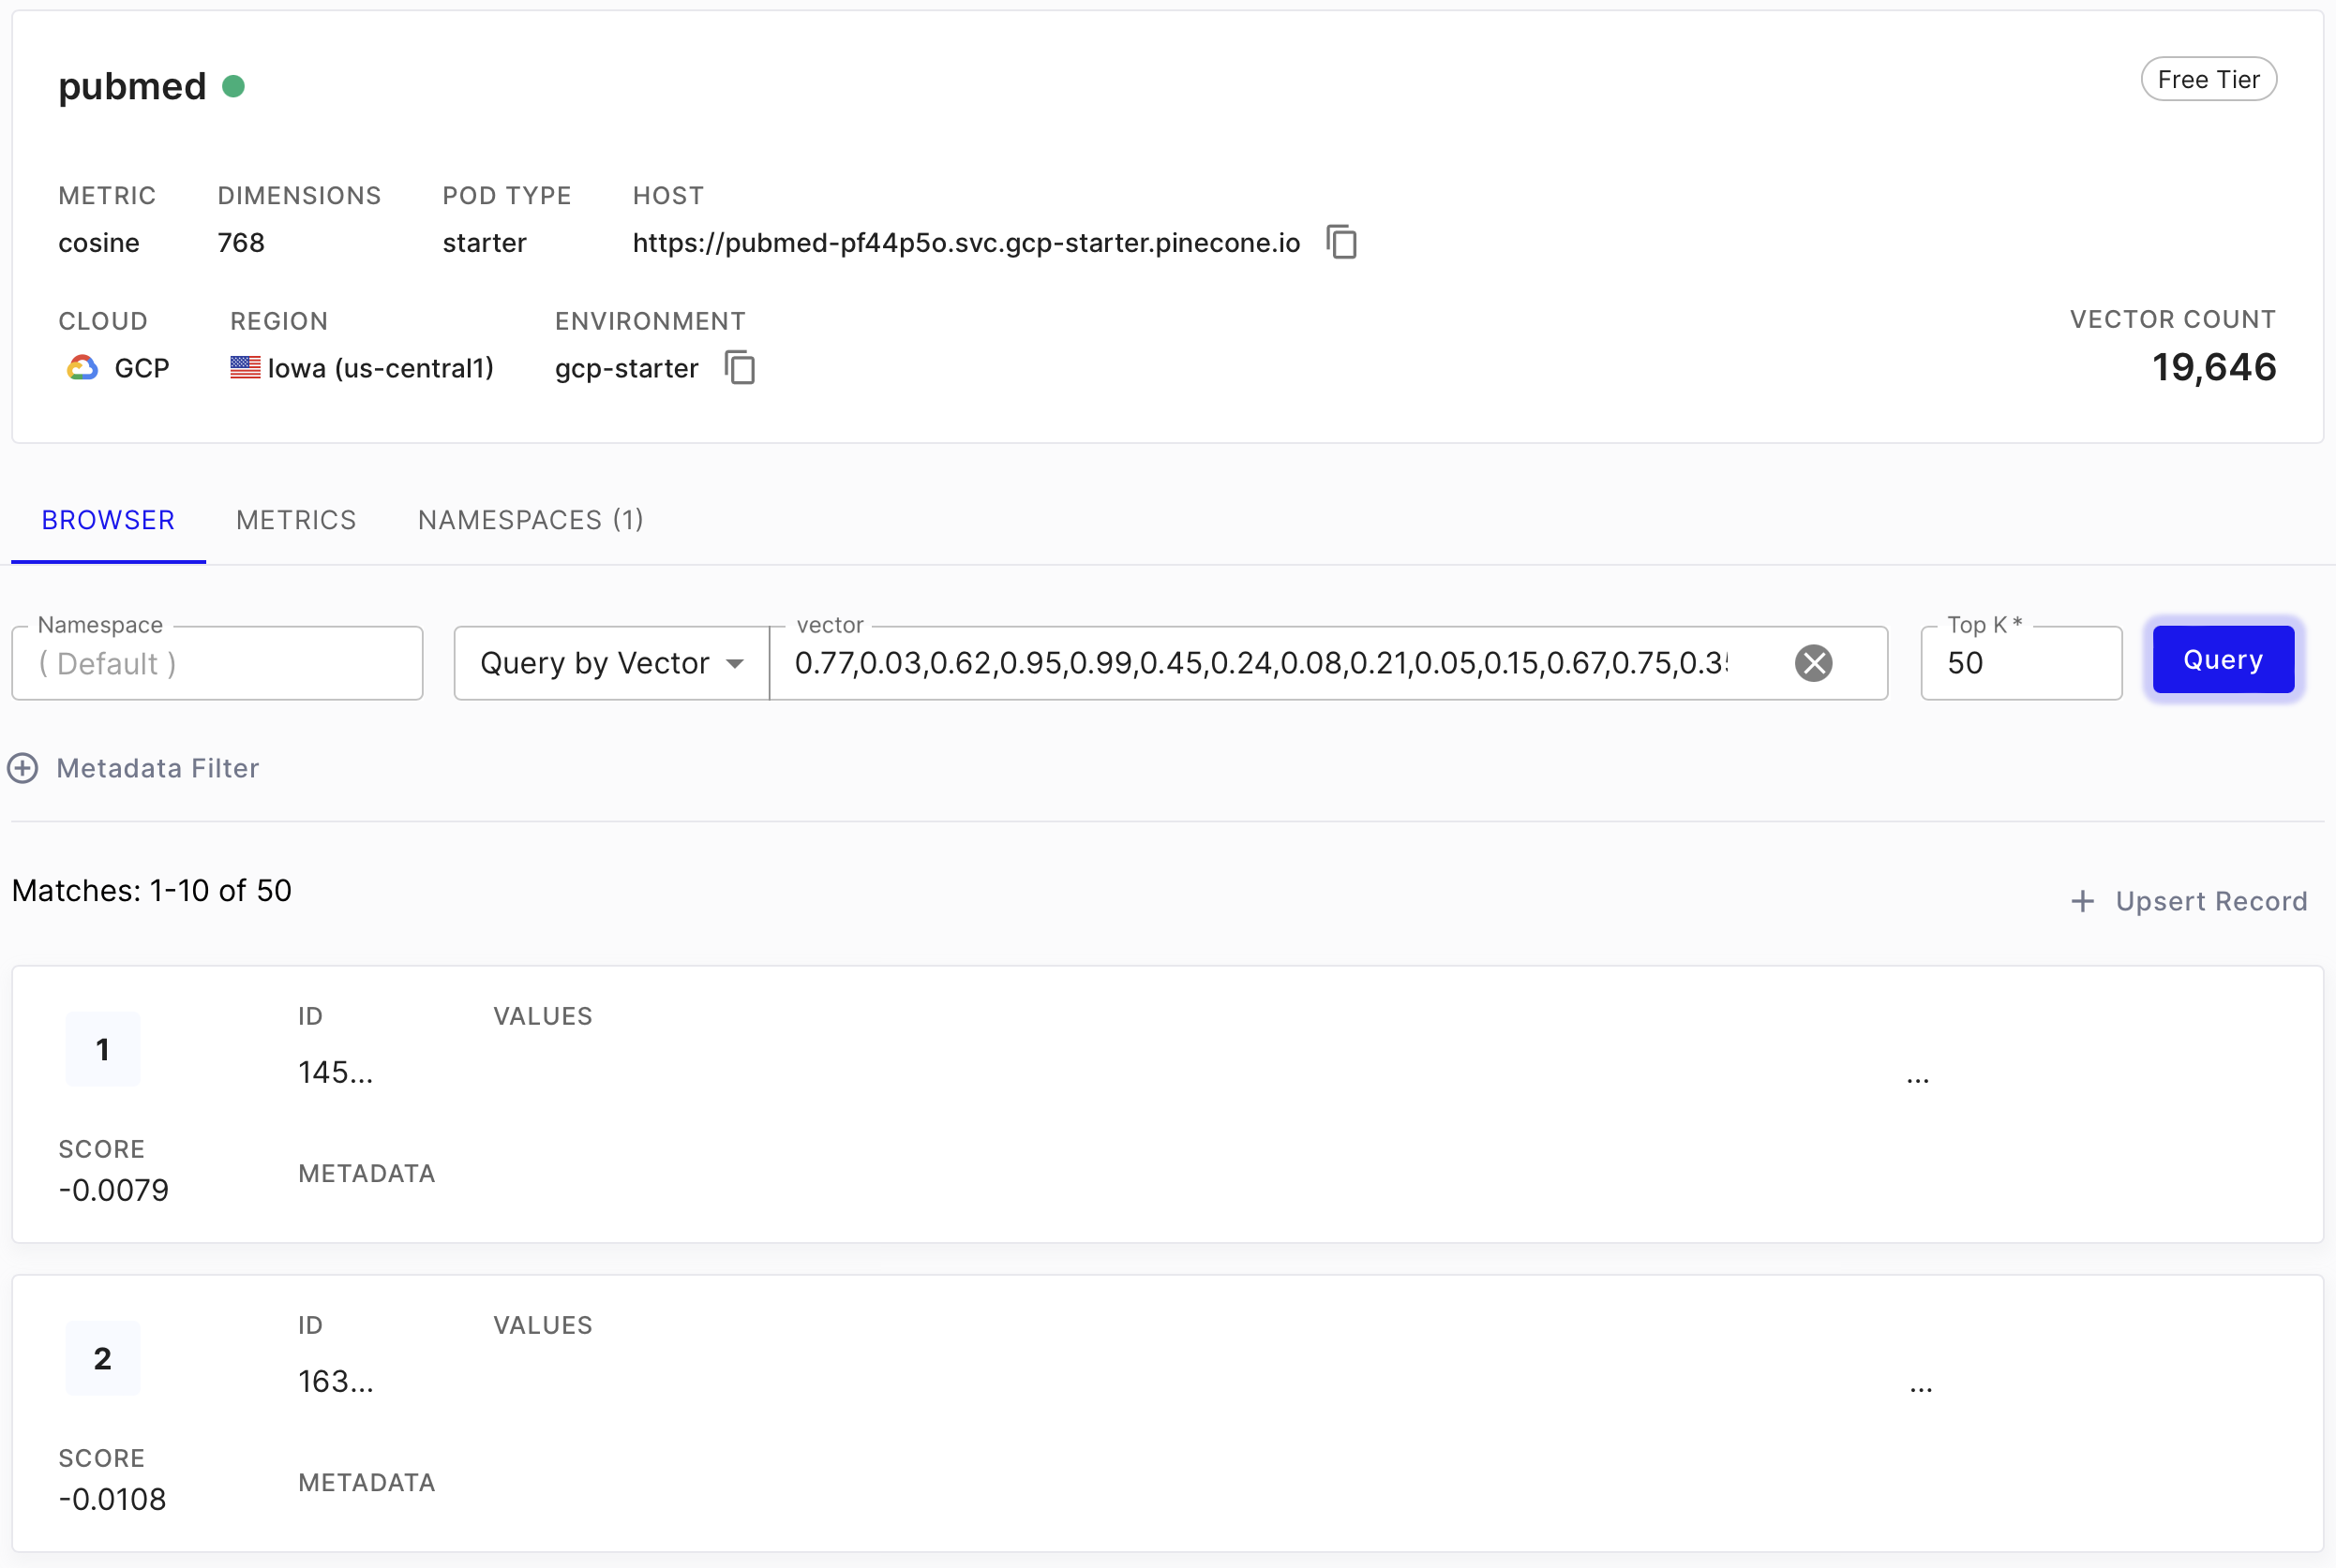
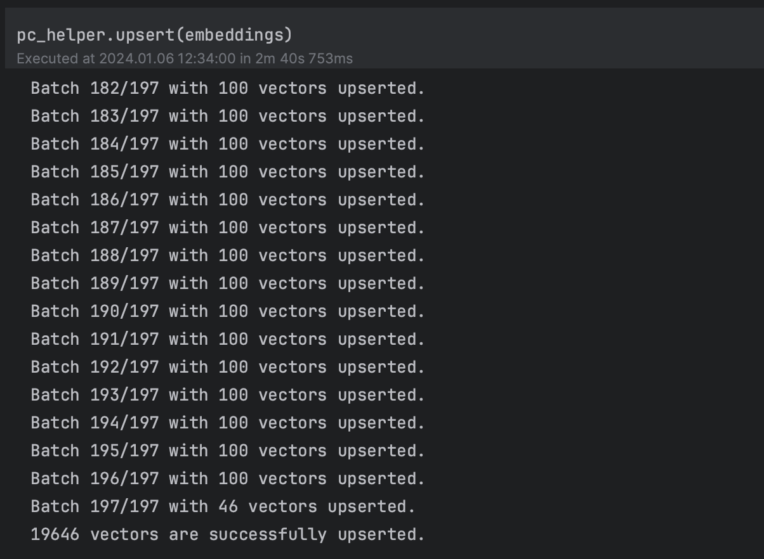
Python script to upload embeddings
Sandra Friebolin, Matteo Malvestiti, Yusuf Berber
Notes:
Fin qua 4 minuti
Description of our problem environment
Emitter with small radius
Collector non in mesh
BCs
Initial refinement at emitter (not distorted mesh, emitter is our interest)

Slide 16
Index
Dataset Download & Pre-Processing
Documents’ Database
Embeddings
Vector Database
Ongoing & Upcoming Steps
Ongoing Steps
We are trying to finetune BioBERT on our dataset
Upcoming Steps
LangChain script for RAG (and put all components together)
Embed abstracts with different models
Introduce a unique identifier to link abstracts on OpenSource to embeddings on Pinecone
Sandra Friebolin, Matteo Malvestiti, Yusuf Berber
Notes:
Poisson formula
Representation of f and why is negligible
BCs

Slide 17
Questions for you
Integration of keyword-based search as hybrid approach?
Integration of metadata?
Evaluation of our embeddings?
Tips for frontend?
…
Sandra Friebolin, Matteo Malvestiti, Yusuf Berber
Notes:
Schema interattivo

